Slide 1
AWS

Slide 2
Amazon EC2 – Basics

Slide 3

Amazon EC2
• EC2 is one of the most popular of AWS offering
• EC2 = Elastic Compute Cloud = Infrastructure as a Service
• It mainly consists in the capability of :
Renting virtual machines (EC2)
Storing data on virtual drives (EBS)
Distributing load across machines (ELB)
Scaling the services using an auto-scaling group (ASG)
• Knowing EC2 is fundamental to understand how the Cloud works

Slide 4
EC2 sizing & configuration options
Operating System (OS): Linux, Windows or Mac OS
How much compute power & cores (CPU)
How much random-access memory (RAM)
How much storage space:
Network-attached (EBS & EFS)
hardware (EC2 Instance Store)
Network card: speed of the card, Public IP address
Firewall rules: security group
Bootstrap script (configure at first launch): EC2 User Data

Slide 5
EC2 User Data
It is possible to bootstrap our instances using an EC2 User data script.
bootstrapping means launching commands when a machine starts
That script is only run once at the instance first start
EC2 user data is used to automate boot tasks such as:
Installing updates
Installing software
Downloading common files from the internet
Anything you can think of
The EC2 User Data Script runs with the root user

Slide 6
Hands-On:
Launching an EC2 Instance running Linux
We’ll be launching our first virtual server using the AWS Console
We’ll get a first high-level approach to the various parameters
We’ll see that our web server is launched using EC2 user data
We’ll learn how to start / stop / terminate our instance.

Slide 7
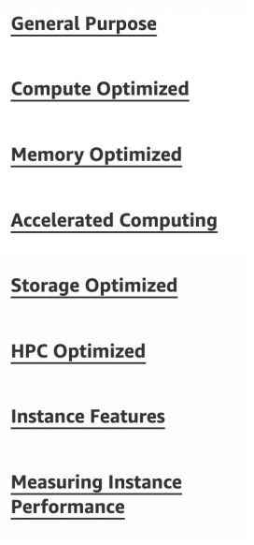
EC2 Instance Types – Overview
You can use different types of EC2 instances that are optimized for different use cases (https://aws.amazon.com/ec2/instance-types/)
AWS has the following naming convention:
m5.2xlarge
m: instance class
5: generation (AWS improves them over time)
2xlarge: size within the instance class

Slide 8
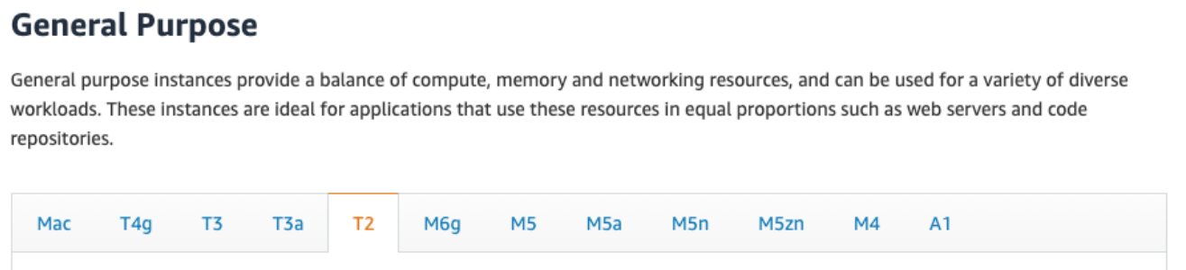
EC2 Instance Types – General Purpose
Great for a diversity of workloads such as web servers or code repositories
Balance between:
Compute
Memory
Networking
In the course, we will be using the t2.micro which is a General Purpose EC2 instance

Slide 9
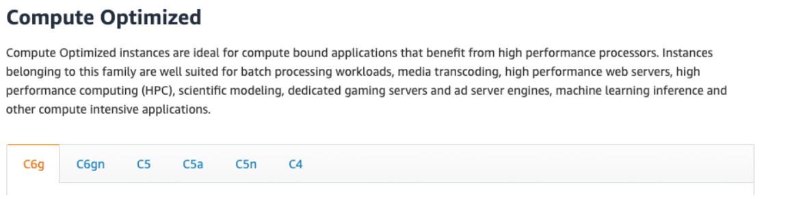
EC2 Instance Types – Compute Optimized
Great for compute-intensive tasks that require high performance processors:
Batch processing workloads
Media transcoding
High performance web servers
High performance computing (HPC)
Scientific modeling & machine learning
Dedicated gaming servers

Slide 10
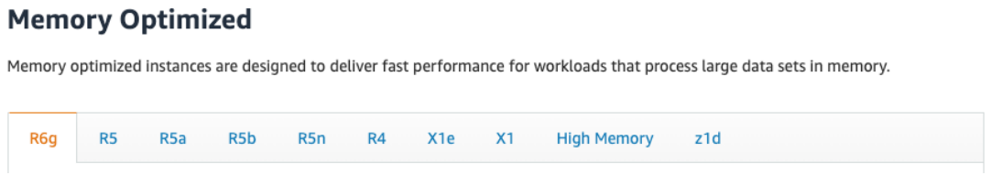
EC2 Instance Types – Memory Optimized
Fast performance for workloads that process large data sets in memory
Use cases:
High performance, relational/non-relational databases
Distributed web scale cache stores
In-memory databases optimized for BI (business intelligence)
Applications performing real-time processing of big unstructured data

Slide 11
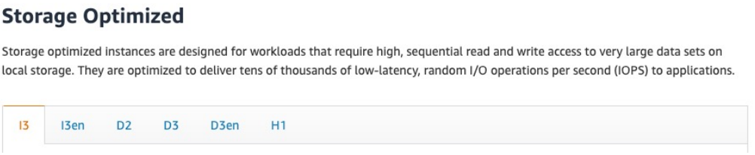
EC2 Instance Types – Storage Optimized
Great for storage-intensive tasks that require high, sequential read and write access to large data sets on local storage
Use cases:
High frequency online transaction processing (OLTP) systems
Relational & NoSQL databases
Cache for in-memory databases (for example, Redis)
Data warehousing applications
Distributed file systems

Slide 12
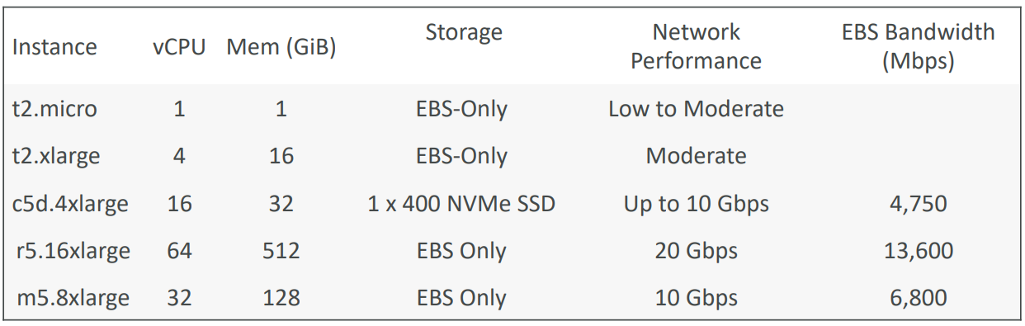
EC2 Instance Types: example
(t2.micro is part of the AWS free tier (up to 750 hours per month))
Great website: https://instances.vantage.sh

Slide 13
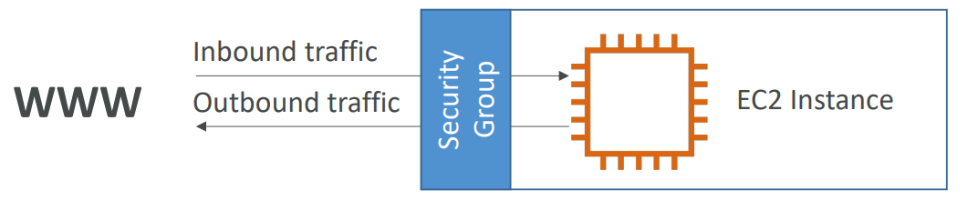
Introduction to Security Groups
• Security Groups are the fundamental of network security in AWS
• They control how traffic is allowed into or out of our EC2 Instances.
• Security groups only contain allow rules
• Security groups rules can reference by IP or by security group

Slide 14
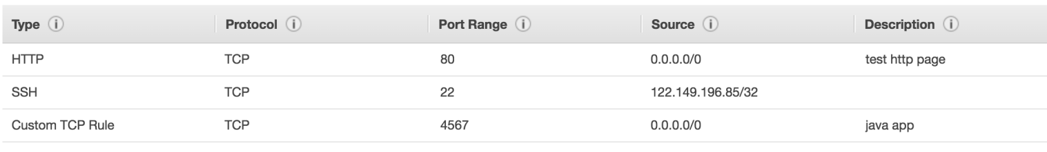
Security Groups Deeper Dive
Security groups are acting as a “firewall” on EC2 instances
They regulate:
Access to Ports
Authorised IP ranges – IPv4 and IPv6
Control of inbound network (from other to the instance)
Control of outbound network (from the instance to other)

Slide 15
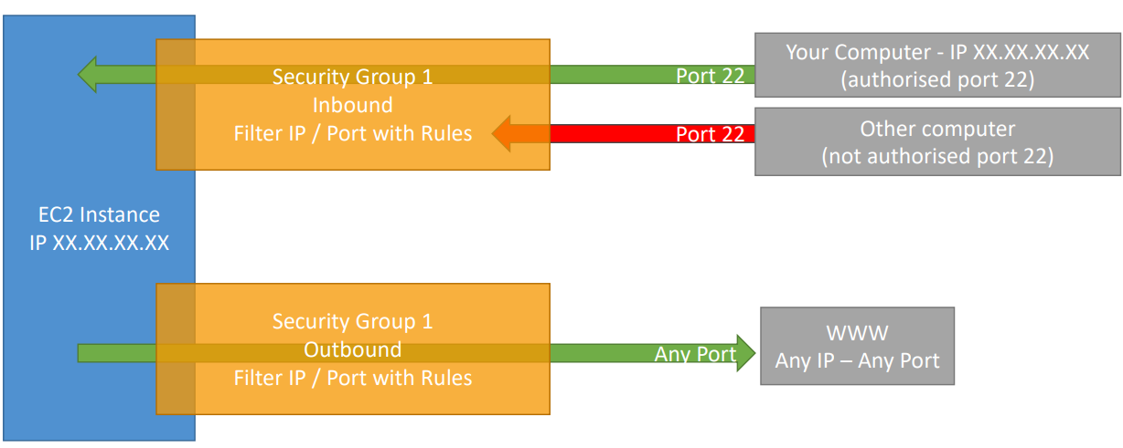
Security Groups Diagram

Slide 16
Security Groups Good to know
Can be attached to multiple instances
Locked down to a region / VPC combination
Does live “outside” the EC2 – if traffic is blocked the EC2 instance won’t see it
It’s good to maintain one separate security group for SSH access
If your application is not accessible (time out), then it’s a security group issue
If your application gives a “connection refused“ error, then it’s an application error or it’s not launched
All inbound traffic is blocked by default
All outbound traffic is authorised by default

Slide 17
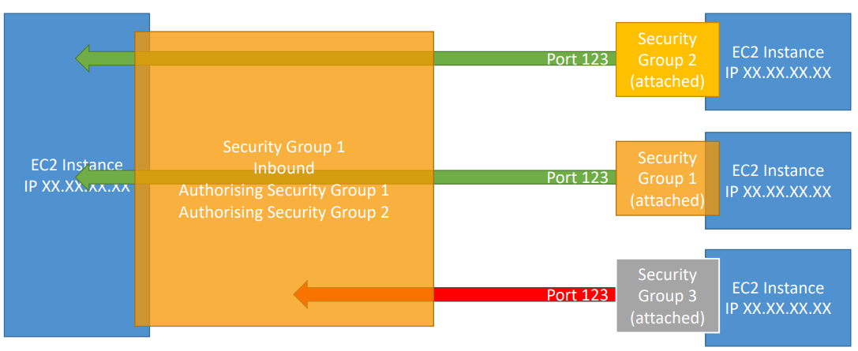
Referencing other security groups Diagram

Slide 18
Classic Ports to know
22 = SSH (Secure Shell) - log into a Linux instance
21 = FTP (File Transfer Protocol) – upload files into a file share
22 = SFTP (Secure File Transfer Protocol) – upload files using SSH
80 = HTTP – access unsecured websites
443 = HTTPS – access secured websites
3389 = RDP (Remote Desktop Protocol) – log into a Windows instance

Slide 19
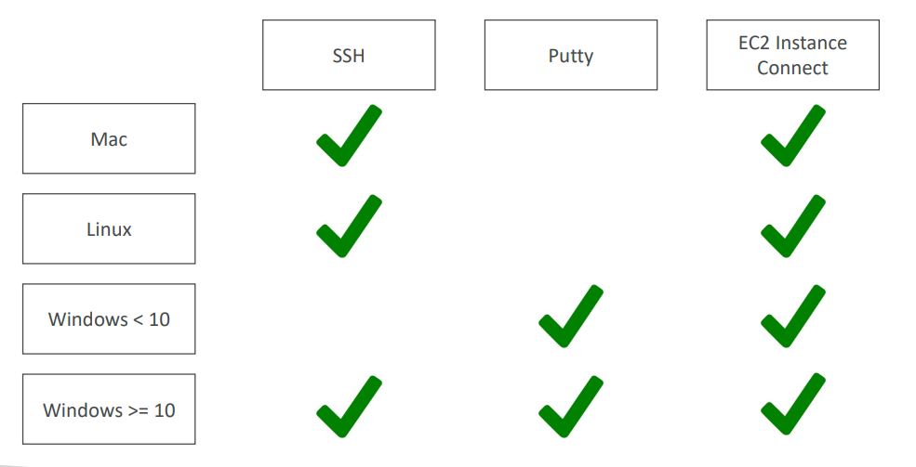
SSH Summary Table

Slide 20
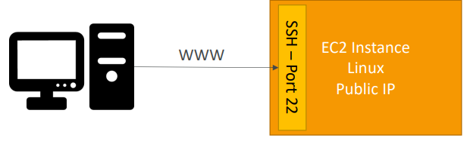
How to SSH into your EC2 Instance Linux / Mac OS X
We’ll learn how to SSH into your EC2 instance using Linux / Mac
SSH is one of the most important function. It allows you to control a remote machine, all using the command line.
We will see how we can configure OpenSSH ~/.ssh/config to facilitate
the SSH into our EC2 instances

Slide 21
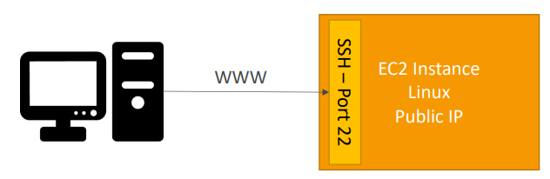
How to SSH into your EC2 Instance
Windows
We’ll learn how to SSH into your EC2 instance using Windows
SSH is one of the most important function. It allows you to control a remote machine, all using the command line.
We will configure all the required parameters necessary for doing SSH on Windows using the free tool Putty.

Slide 22
EC2 Instance Connect
Connect to your EC2 instance within your browser
No need to use your key file that was downloaded
The “magic” is that a temporary key is uploaded onto EC2 by AWS
Works only out-of-the-box with Amazon Linux 2
Need to make sure the port 22 is still opened!

Slide 23
EC2 Instances Purchasing Options
On-Demand Instances – short workload, predictable pricing, pay by second
Reserved (1 & 3 years)
Reserved Instances – long workloads
Convertible Reserved Instances – long workloads with flexible instances
Savings Plans (1 & 3 years) –commitment to an amount of usage, long workload
Spot Instances – short workloads, cheap, can lose instances (less reliable)
Dedicated Hosts – book an entire physical server, control instance placement
Dedicated Instances – no other customers will share your hardware
Capacity Reservations – reserve capacity in a specific AZ for any duration

Slide 24
EC2 On Demand
Pay for what you use:
Linux or Windows - billing per second, after the first minute
All other operating systems - billing per hour
Has the highest cost but no upfront payment
No long-term commitment
Recommended for short-term and un-interrupted workloads, where you can't predict how the application will behave

Slide 25
EC2 Reserved Instances
Up to 72% discount compared to On-demand
You reserve a specific instance attributes (Instance Type, Region, Tenancy, OS)
Reservation Period – 1 year (+discount) or 3 years (+++discount)
Payment Options – No Upfront (+), Partial Upfront (++), All Upfront (+++)
Reserved Instance’s Scope – Regional or Zonal (reserve capacity in an AZ)
Recommended for steady-state usage applications (think database)
You can buy and sell in the Reserved Instance Marketplace
Convertible Reserved Instance
Can change the EC2 instance type, instance family, OS, scope and tenancy
Up to 66% discount

Slide 26
EC2 Savings Plans
Get a discount based on long-term usage (up to 72% - same as RIs)
Commit to a certain type of usage ($10/hour for 1 or 3 years)
Usage beyond EC2 Savings Plans is billed at the On-Demand price
Locked to a specific instance family & AWS region (e.g., M5 in us-east-1)
Flexible across:
Instance Size (e.g., m5.xlarge, m5.2xlarge)
OS (e.g., Linux, Windows)
Tenancy (Host, Dedicated, Default)

Slide 27
EC2 Spot Instances
Can get a discount of up to 90% compared to On-demand
Instances that you can “lose” at any point of time if your max price is less than the current spot price
The MOST cost-efficient instances in AWS
Useful for workloads that are resilient to failure
Batch jobs
Data analysis
Image processing
Any distributed workloads
Workloads with a flexible start and end time
Not suitable for critical jobs or databases

Slide 28
EC2 Dedicated Hosts
A physical server with EC2 instance capacity fully dedicated to your use
Allows you address compliance requirements and use your existing server- bound software licenses (per-socket, per-core, pe—VM software licenses)
Purchasing Options:
On-demand – pay per second for active Dedicated Host
Reserved - 1 or 3 years (No Upfront, Partial Upfront, All Upfront)
The most expensive option
Useful for software that have complicated licensing model (BYOL – Bring Your Own License)
Or for companies that have strong regulatory or compliance needs

Slide 29
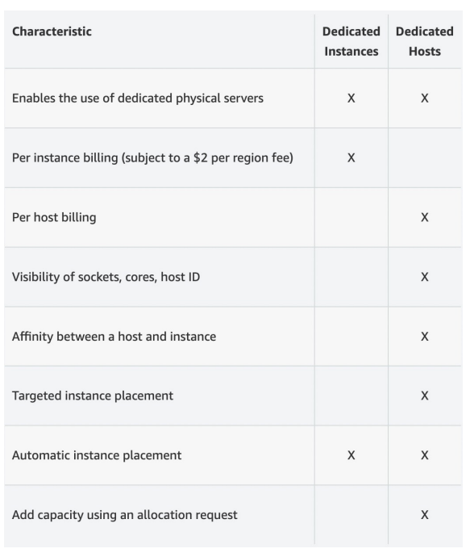
EC2 Dedicated Instances
• Instances run on hardware that’s dedicated to you
• May share hardware with other instances in same account
• No control over instance placement
(can move hardware after Stop / Start)

Slide 30
EC2 Capacity Reservations
• Reserve On-Demand instances capacity in a specific AZ for any duration
• You always have access to EC2 capacity when you need it
• No time commitment (create/cancel anytime), no billing discounts
• Combine with Regional Reserved Instances and Savings Plans to benefit
from billing discounts
• You’re charged at On-Demand rate whether you run instances or not
• Suitable for short-term, uninterrupted workloads that needs to be in a specific AZ

Slide 31

Which purchasing option is right for me?
• On demand: coming and staying in resort whenever we like, we pay the full price
• Reserved: like planning ahead and if we plan to stay for a long time, we may get a good discount.
• Savings Plans: pay a certain amount per hour for certain period and stay in any room type (e.g., King, Suite, Sea View, …)
• Spot instances: the hotel allows people to bid for the empty rooms and the highest bidder keeps the rooms. You can get kicked out at any time
• Dedicated Hosts: We book an entire building of the resort
• Capacity Reservations: you book a room for a period with full price even you don’t stay in it

Slide 32
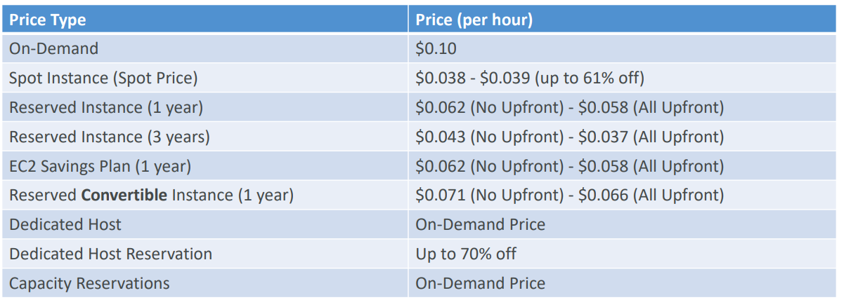
Price Comparison Example – m4.large – us-east-1

Slide 33
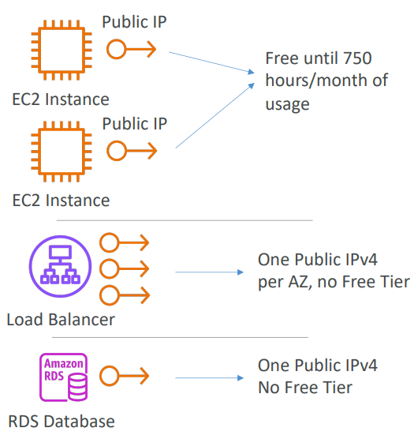
AWS charges for IPv4 addresses
Starting February 1st 2024, there’s a charge
for all Public IPv4 created in your account
$0.005 per hour of Public IPv4 (~ $3.6 per month)
For new accounts in AWS, you have a free tier for
the EC2 service: 750 hours of Public IPv4 per
month for the first 12 months
For all other services there is
no free tier

Slide 34
Private vs Public IP (IPv4)
Networking has two sorts of IPs. IPv4 and IPv6:
IPv4: 1.160.10.240
IPv6: 3ffe:1900:4545:3:200:f8ff:fe21:67cf
we will only be using IPv4.
IPv4 is still the most common format used online.
IPv6 is newer and solves problems for the Internet of Things (IoT).
IPv4 allows for 3.7 billion different addresses in the public space
IPv4: [0-255].[0-255].[0-255].[0-255]

Slide 35
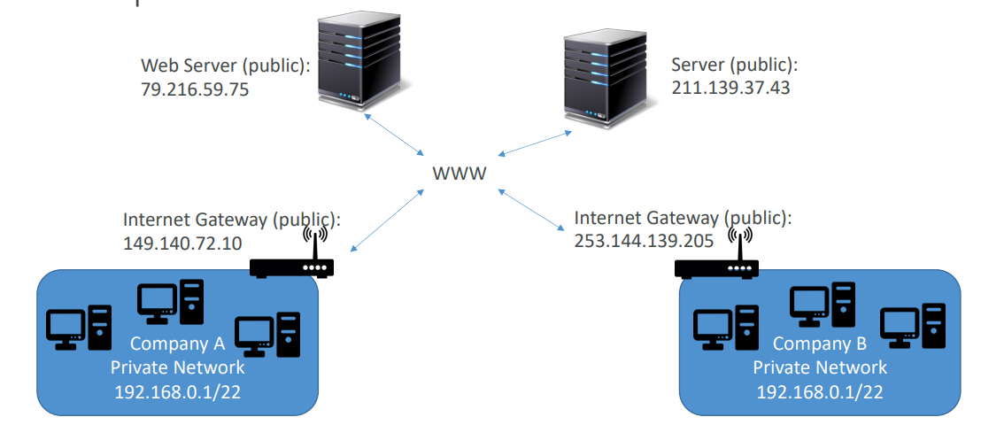
Private vs Public IP (IPv4) Example

Slide 36
Private vs Public IP (IPv4)
Fundamental Differences
Public IP:
Public IP means the machine can be identified on the internet (WWW)
Must be unique across the whole web (not two machines can have the same public IP).
Can be geo-located easily
Private IP:
Private IP means the machine can only be identified on a private network only
The IP must be unique across the private network
BUT two different private networks (two companies) can have the same IPs.
Machines connect to WWW using a NAT + internet gateway (a proxy)
Only a specified range of IPs can be used as private IP

Slide 37
Elastic Ips
When you stop and then start an EC2 instance, it can change its public IP.
If you need to have a fixed public IP for your instance, you need an Elastic IP
An Elastic IP is a public IPv4 IP you own as long as you don’t delete it
You can attach it to one instance at a time
You can only have 5 Elastic IP in your account (you can ask AWS to increase that).

Slide 38
EC2 Section – Summary
• EC2 Instance: AMI (OS) + Instance Size (CPU + RAM) + Storage +
security groups + EC2 User Data
• Security Groups: Firewall attached to the EC2 instance
• EC2 User Data: Script launched at the first start of an instance
• SSH: start a terminal into our EC2 Instances (port 22)
• EC2 Instance Role: link to IAM roles
• Purchasing Options: On-Demand, Spot, Reserved (Standard +
Convertible), Dedicated Host, Dedicated Instance

Slide 39
EC2 Instance Storage Section

Slide 40
What’s an EBS Volume?
• An EBS (Elastic Block Store) Volume is a network drive you can attach to your instances while they run
• It allows your instances to persist data, even after their termination
• They can only be mounted to one instance at a time
• They are bound to a specific availability zone
• Free tier: 30 GB of free EBS storage of type General Purpose (SSD) or Magnetic per month

Slide 41
EBS Volume
It’s a network drive (i.e. not a physical drive)
It uses the network to communicate the instance, which means there might be a bit of latency
It can be detached from an EC2 instance and attached to another one quickly
It’s locked to an Availability Zone (AZ)
An EBS Volume in us-east-1a cannot be attached to us-east-1b
To move a volume across, you first need to snapshot it
Have a provisioned capacity (size in GBs, and IOPS)
You get billed for all the provisioned capacity
You can increase the capacity of the drive over time

Slide 42
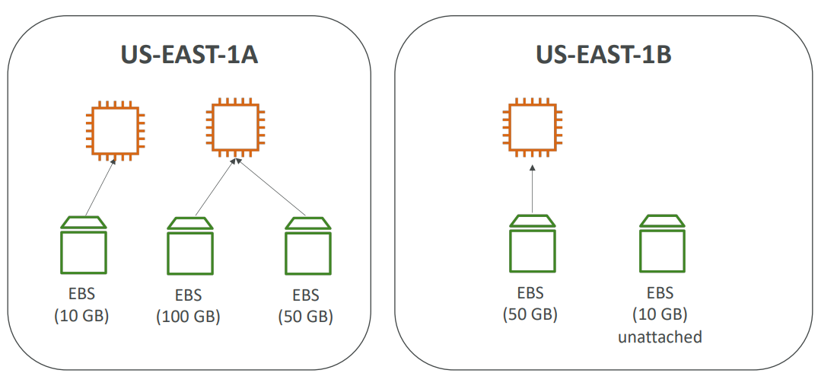
EBS Volume - Example

Slide 43
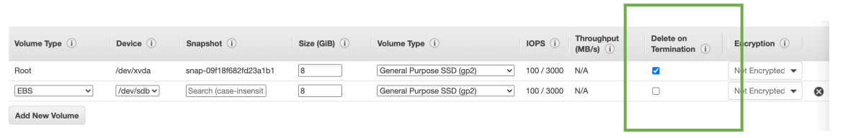
EBS – Delete on Termination attribute
Controls the EBS behavior when an EC2 instance terminates
By default, the root EBS volume is deleted (attribute enabled)
By default, any other attached EBS volume is not deleted (attribute disabled)
This can be controlled by the AWS console / AWS CLI
Use case: preserve root volume when instance is terminated

Slide 44
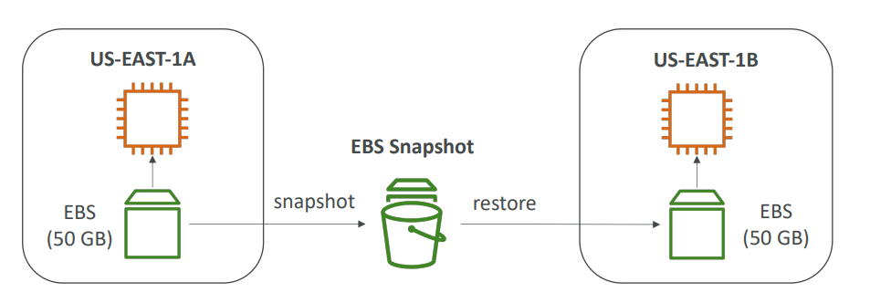
EBS Snapshots
• Make a backup (snapshot) of your EBS volume at a point in time
• Not necessary to detach volume to do snapshot, but recommended
• Can copy snapshots across AZ or Region

Slide 45
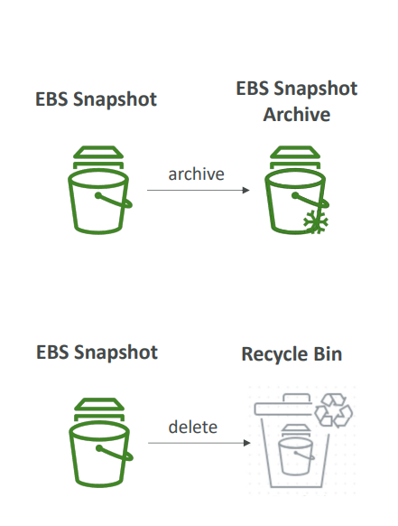
EBS Snapshots Features
• EBS Snapshot Archive
• Move a Snapshot to an ”archive tier” that is 75% cheaper
• Takes within 24 to 72 hours for restoring the archive
• Recycle Bin for EBS Snapshots
• Setup rules to retain deleted snapshots so you can recover
them after an accidental deletion
• Specify retention (from 1 day to 1 year)

Slide 46
AMI Overview
• AMI = Amazon Machine Image
• AMI are a customization of an EC2 instance
You add your own software, configuration, operating system, monitoring…
Faster boot / configuration time because all your software is pre-packaged
• AMI are built for a specific region (and can be copied across regions)
• You can launch EC2 instances from:
A Public AMI: AWS provided
Your own AMI: you make and maintain them yourself
An AWS Marketplace AMI: an AMI someone else made (and potentially sells)

Slide 47
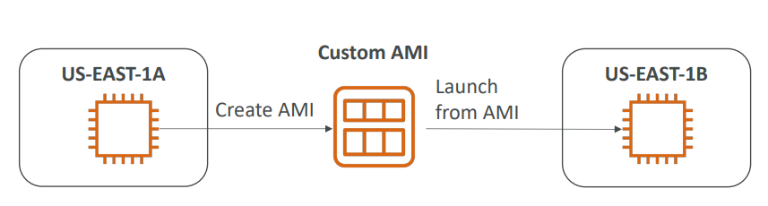
AMI Process (from an EC2 instance)
Start an EC2 instance and customize it
Stop the instance (for data integrity)
Build an AMI – this will also create EBS snapshots
Launch instances from other AMIs

Slide 48
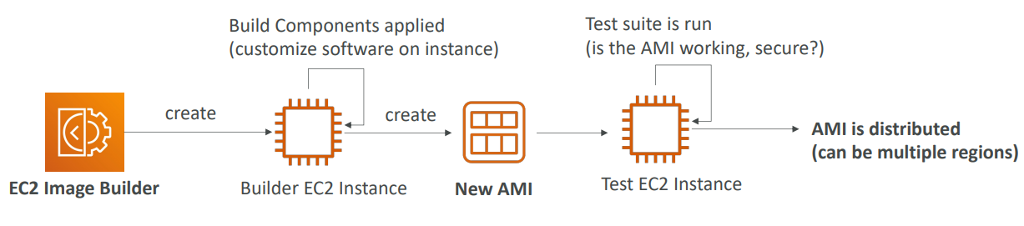
EC2 Image Builder
• Used to automate the creation of Virtual Machines or container images
• => Automate the creation, maintain, validate and test EC2 AMIs
• Can be run on a schedule (weekly, whenever packages are updated, etc…)
• Free service (only pay for the underlying resources)

Slide 49
EC2 Instance Store
EBS volumes are network drives with good but “limited” performance
If you need a high-performance hardware disk, use EC2 Instance Store
Better I/O performance
EC2 Instance Store lose their storage if they’re stopped (ephemeral)
Good for buffer / cache / temporary content
Risk of data loss if hardware fails
Backups and Replication are your responsibility

Slide 50
EBS Volume Types
• EBS Volumes come in 6 types
gp2 / gp3 (SSD): General purpose SSD volume that balances price and performance for
a wide variety of workloads
io1 / io2 Block Express (SSD): Highest-performance SSD volume for mission-critical
low-latency or high-throughput workloads
st1 (HDD): Low-cost HDD volume designed for frequently accessed, throughput- intensive workloads
sc1 (HDD): Lowest cost HDD volume designed for less frequently accessed workloads
• EBS Volumes are characterized in Size | Throughput | IOPS (I/O Ops Per Sec)
• When in doubt always consult the AWS documentation – it’s good!
• Only gp2/gp3 and io1/io2 Block Express can be used as boot volumes

Slide 51
EBS Volume Types Use cases
General Purpose SSD
• Cost effective storage, low-latency
• System boot volumes, Virtual desktops, Development and test environments
• 1 GiB - 16 TiB
• gp3:
Baseline of 3,000 IOPS and throughput of 125 MiB/s
Can increase IOPS up to 16,000 and throughput up to 1000 MiB/s independently
• gp2:
Small gp2 volumes can burst IOPS to 3,000
Size of the volume and IOPS are linked, max IOPS is 16,000
3 IOPS per GB, means at 5,334 GB we are at the max IOPS

Slide 52
EBS Volume Types Use cases
Provisioned IOPS (PIOPS) SSD
• Critical business applications with sustained IOPS performance
• Or applications that need more than 16,000 IOPS
• Great for databases workloads (sensitive to storage perf and consistency)
• io1 (4 GiB - 16 TiB):
Max PIOPS: 64,000 for Nitro EC2 instances & 32,000 for other
Can increase PIOPS independently from storage size
• io2 Block Express (4 GiB – 64 TiB):
Sub-millisecond latency
Max PIOPS: 256,000 with an IOPS:GiB ratio of 1,000:1
• Supports EBS Multi-attach

Slide 53
EBS Volume Types Use cases
Hard Disk Drives (HDD)
• Cannot be a boot volume
• 125 GiB to 16 TiB
• Throughput Optimized HDD (st1)
Big Data, Data Warehouses, Log Processing
Max throughput 500 MiB/s – max IOPS 500
• Cold HDD (sc1):
For data that is infrequently accessed
Scenarios where lowest cost is important
Max throughput 250 MiB/s – max IOPS 250

Slide 54
EBS Encryption
• When you create an encrypted EBS volume, you get the following:
Data at rest is encrypted inside the volume
All the data in flight moving between the instance and the volume is encrypted
All snapshots are encrypted
All volumes created from the snapshot
• Encryption and decryption are handled transparently (you have nothing to do)
• Encryption has a minimal impact on latency
• EBS Encryption leverages keys from KMS (AES-256)
• Copying an unencrypted snapshot allows encryption
• Snapshots of encrypted volumes are encrypted

Slide 55
Encryption: encrypt an unencrypted EBS volume
• Create an EBS snapshot of the volume
• Encrypt the EBS snapshot ( using copy )
• Create new ebs volume from the snapshot ( the volume will also be
encrypted )
• Now you can attach the encrypted volume to the original instance

Slide 56
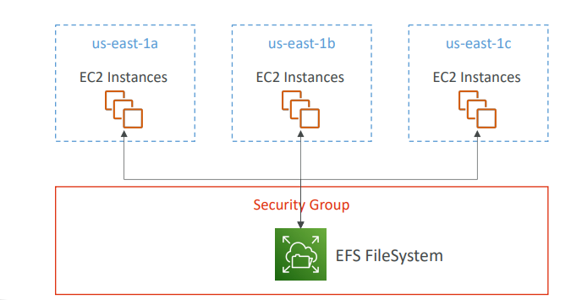
EFS – Elastic File System
• Managed NFS (network file system) that can be mounted on 100s of EC2
• EFS works with Linux EC2 instances in multi-AZ • Use cases: content management, web serving, data sharing, Wordpress
• Highly available, scalable, expensive (3x gp2), pay per use, no capacity planning

Slide 57
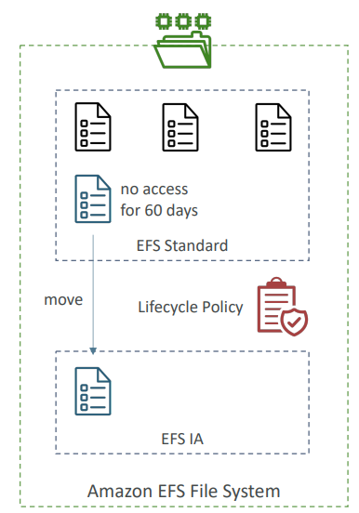
EFS Infrequent Access (EFS-IA)
• Storage class that is cost-optimized for files not
accessed every day
• Up to 92% lower cost compared to EFS Standard
• EFS will automatically move your files to EFS-IA
based on the last time they were accessed
• Enable EFS-IA with a Lifecycle Policy
• Example: move files that are not accessed for 60
days to EFS-IA
• Transparent to the applications accessing EFS

Slide 58
EFS – Storage Classes
• Storage Tiers (lifecycle management feature – move file after N days)
Standard: for frequently accessed files
Infrequent access (EFS-IA): cost to retrieve files, lower price to store.
Archive: rarely accessed data (few times each year), 50% cheaper
Implement lifecycle policies to move files between storage tiers
• Availability and durability
Standard: Multi-AZ, great for prod
One Zone: One AZ, great for dev, backup enabled by default, compatible with IA (EFS One Zone-IA)
• Over 90% in cost savings

Slide 59
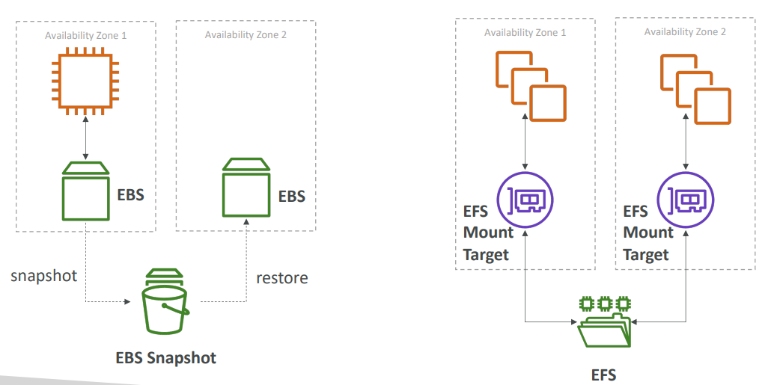
EBS vs EFS

Slide 60
EBS vs EFS – Elastic File System
• Mounting 100s of instances across AZ
• EFS share website files (WordPress)
• Only for Linux Instances (POSIX)
• EFS has a higher price point than EBS
• Can leverage Storage Tiers for cost savings
• Remember: EFS vs EBS vs Instance Store

Slide 61
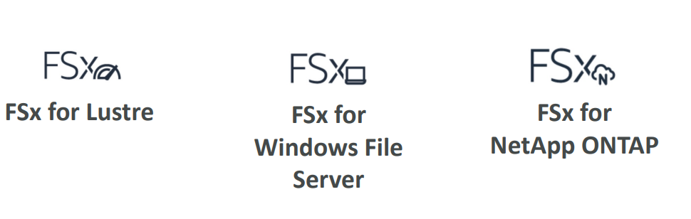
Amazon FSx – Overview
• Launch 3rd party high-performance file systems on AWS
• Fully managed service

Slide 62
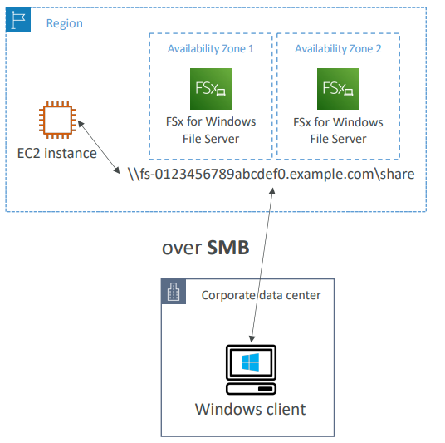
Amazon FSx for Windows File Server
• A fully managed, highly reliable, and scalable
Windows native shared file system
• Built on Windows File Server
• Supports SMB protocol &
Windows NTFS
• Integrated with Microsoft Active Directory
• Can be accessed from AWS or
your on-premise infrastructure

Slide 63
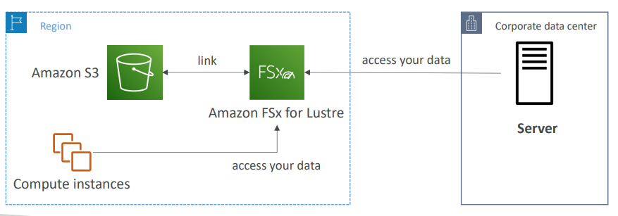
Amazon FSx for Lustre
• A fully managed, high-performance, scalable file storage for High Performance Computing (HPC)
• The name Lustre is derived from “Linux” and “cluster”
• Machine Learning, Analytics, Video Processing, Financial Modeling, …
• Scales up to 100s GB/s, millions of IOPS, sub-ms latencies

Slide 64
EC2 Instance Storage - Summary
EBS volumes:
network drives attached to one EC2 instance at a time
Mapped to an Availability Zones
Can use EBS Snapshots for backups / transferring EBS volumes across AZ
AMI: create ready-to-use EC2 instances with our customizations
EC2 Image Builder: automatically build, test and distribute AMIs
EC2 Instance Store:
High performance hardware disk attached to our EC2 instance
Lost if our instance is stopped / terminated
EFS: network file system, can be attached to 100s of instances in a region
EFS-IA: cost-optimized storage class for infrequent accessed files
FSx for Windows: Network File System for Windows servers
FSx for Lustre: High Performance Computing Linux file system

